Slide 1
02 - Introduction to Angular-5 (A Framework of JavaScript)
PANKAJ KAPOOR
(Your trainer)

Slide 2

Overview
What is NO SQL Data base?
What is Mongo DB?
What is database, collection and documents
Why Mongo DB?
Advantages of MongoDB over RDBMS
Where to Use MongoDB?
Mongo DB Architecture.
Document (JSON) Structure.
Different Methods.
When to use Mongo DB?

Slide 3
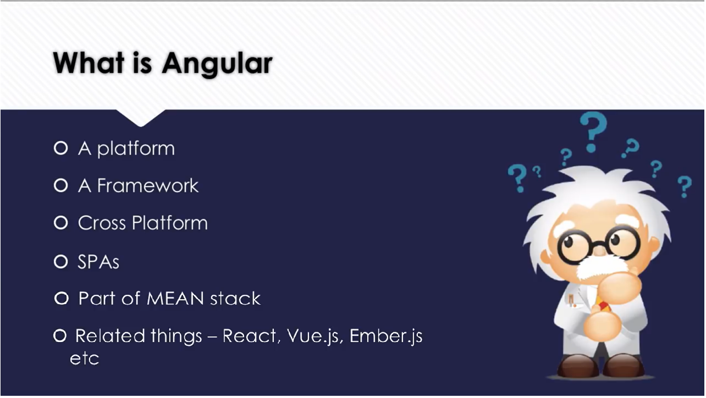
What is No SQl data base
It’s Not No SQL it’s NOT ONLY SQL.
It’s not even a replacement to RDBMS.
As compared to the good olden days we are saving more and more data.

Slide 4
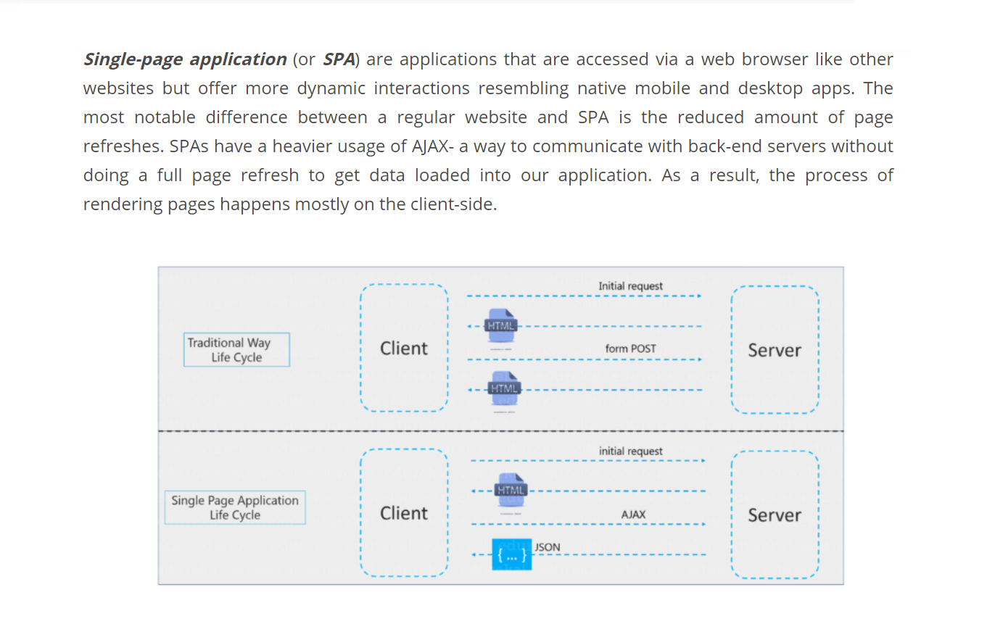

Slide 5

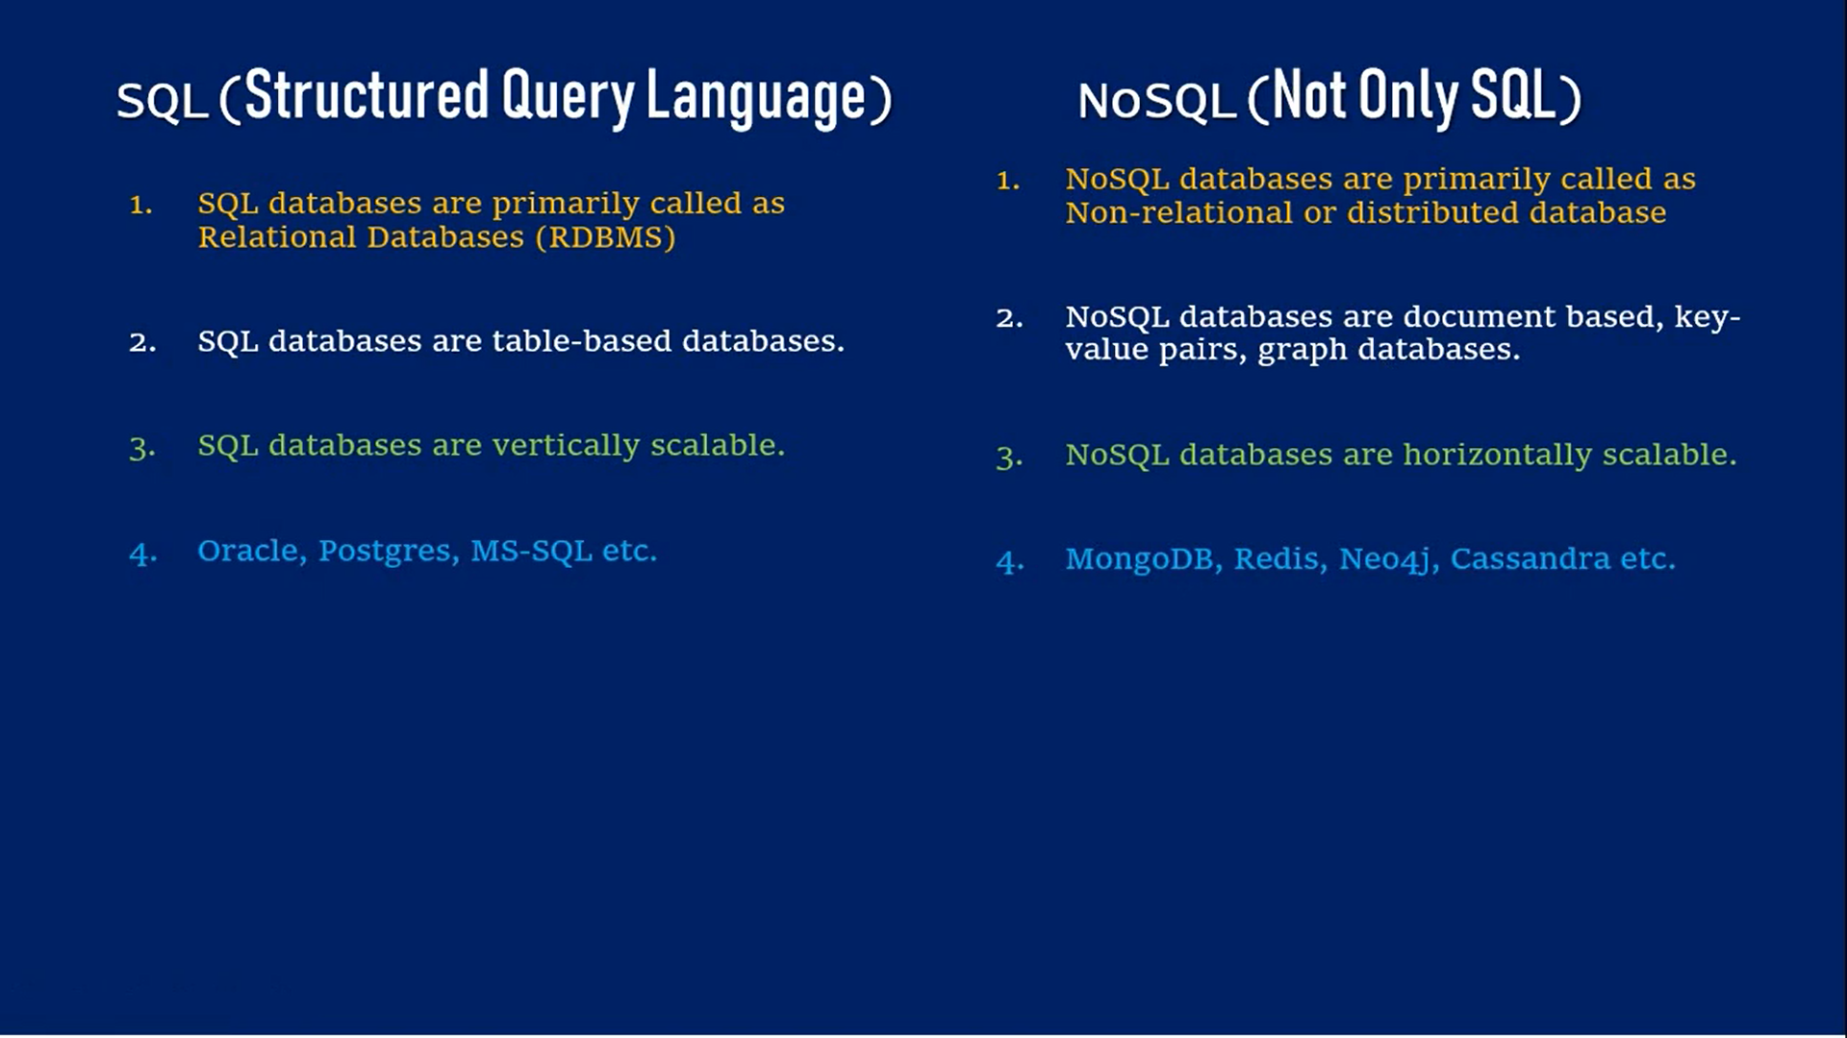
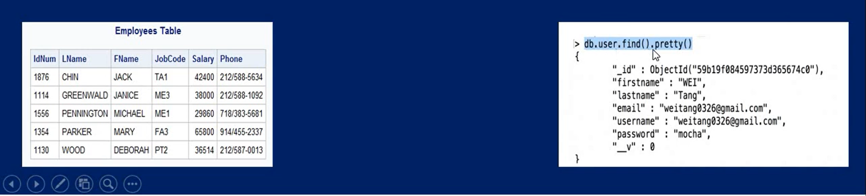
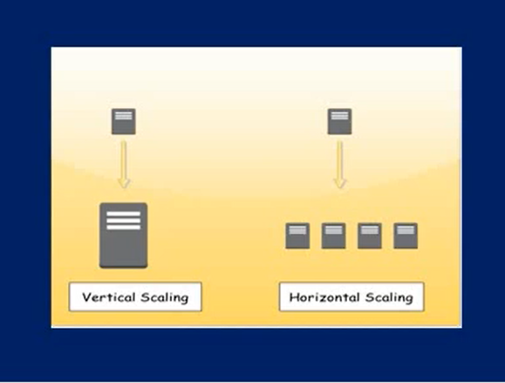

Slide 6
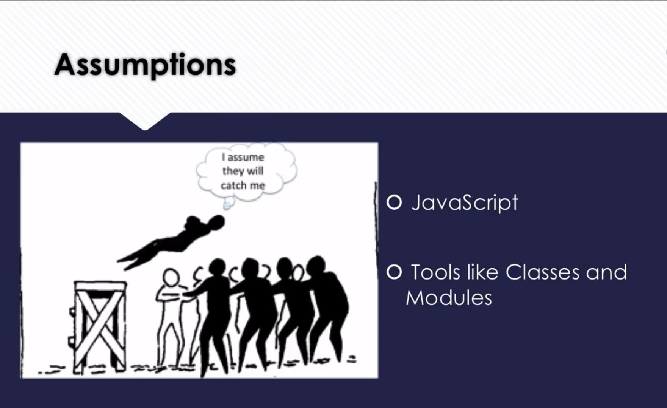
What is Mongo DB
MongoDB is a cross-platform, document oriented database that provides
High performance.
High availability.
Easy scalability.
MongoDB works on concept of collection and document.

Slide 7
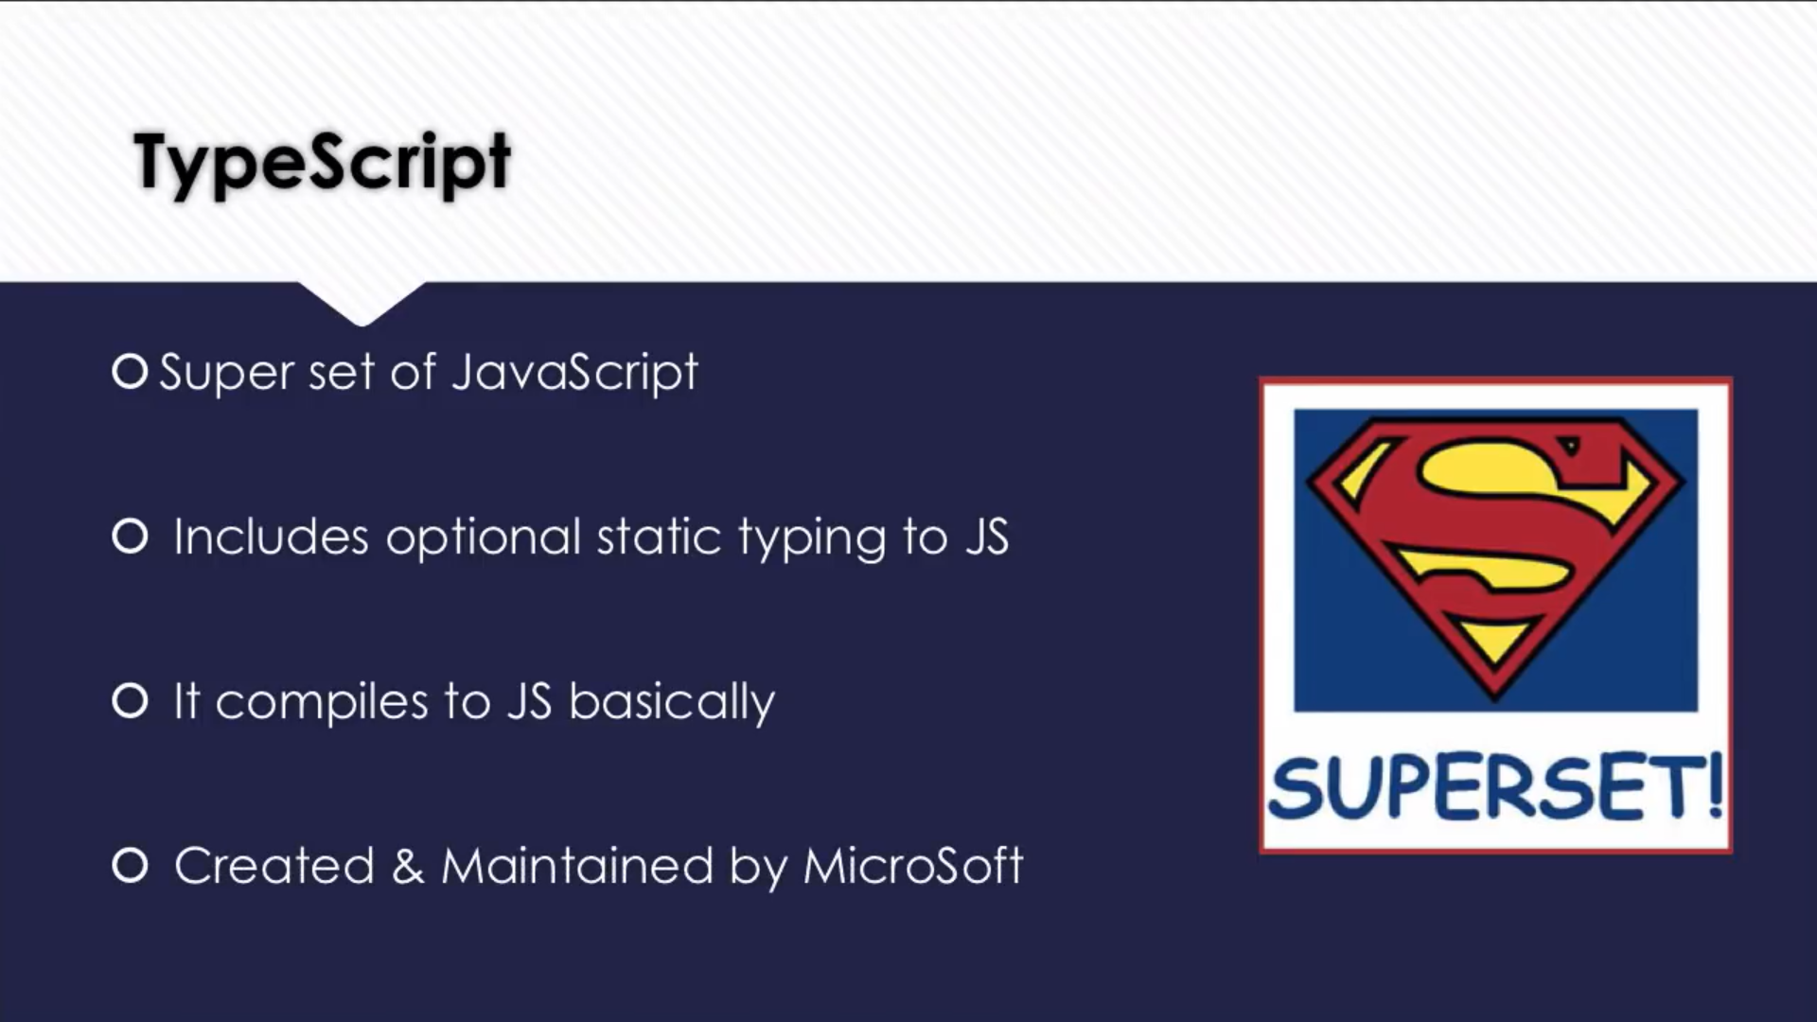
Database – Collection - Document
Database
Database is a physical container for collections. Each database gets its own set of files on the file system. A single MongoDB server typically has multiple databases.
Collection
Collection is a group of MongoDB documents. It is the equivalent of an RDBMS table. A collection exists within a single database. Collections do not enforce a schema. Documents within a collection can have different fields. Typically, all documents in a collection are of similar or related purpose.
Document
A document is a set of key-value pairs. Documents have dynamic schema. Dynamic schema means that documents in the same collection do not need to have the same set of fields or structure, and common fields in a collection's documents may hold different types of data.

Slide 8
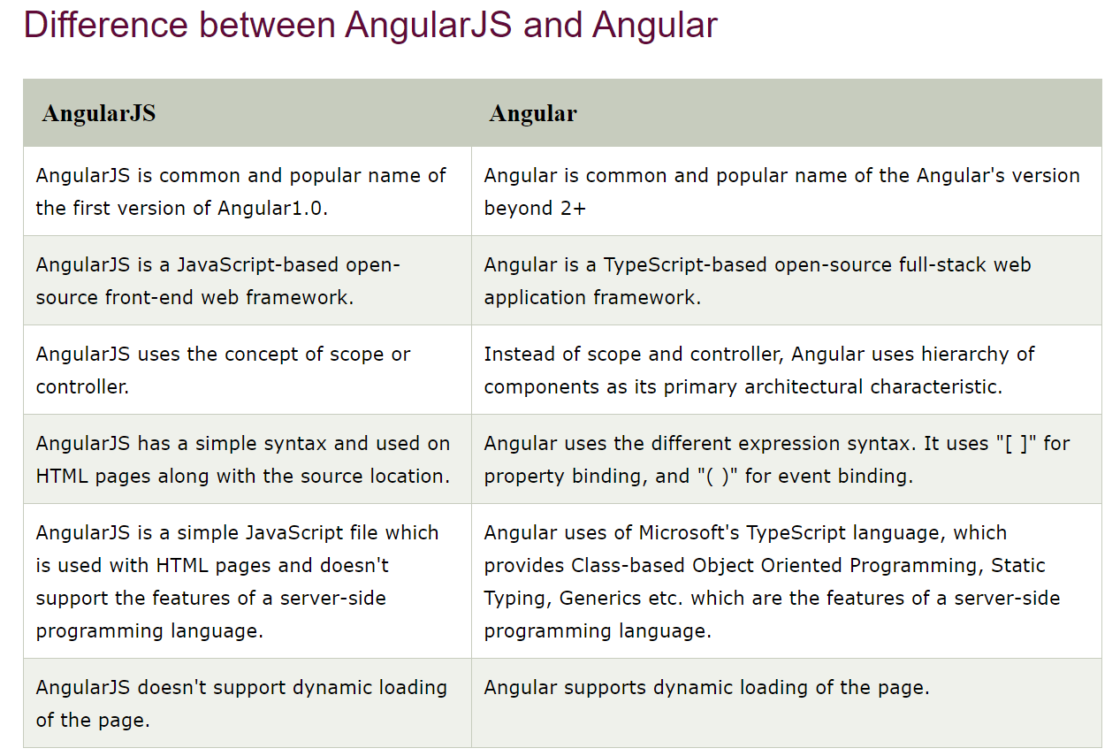

Slide 9
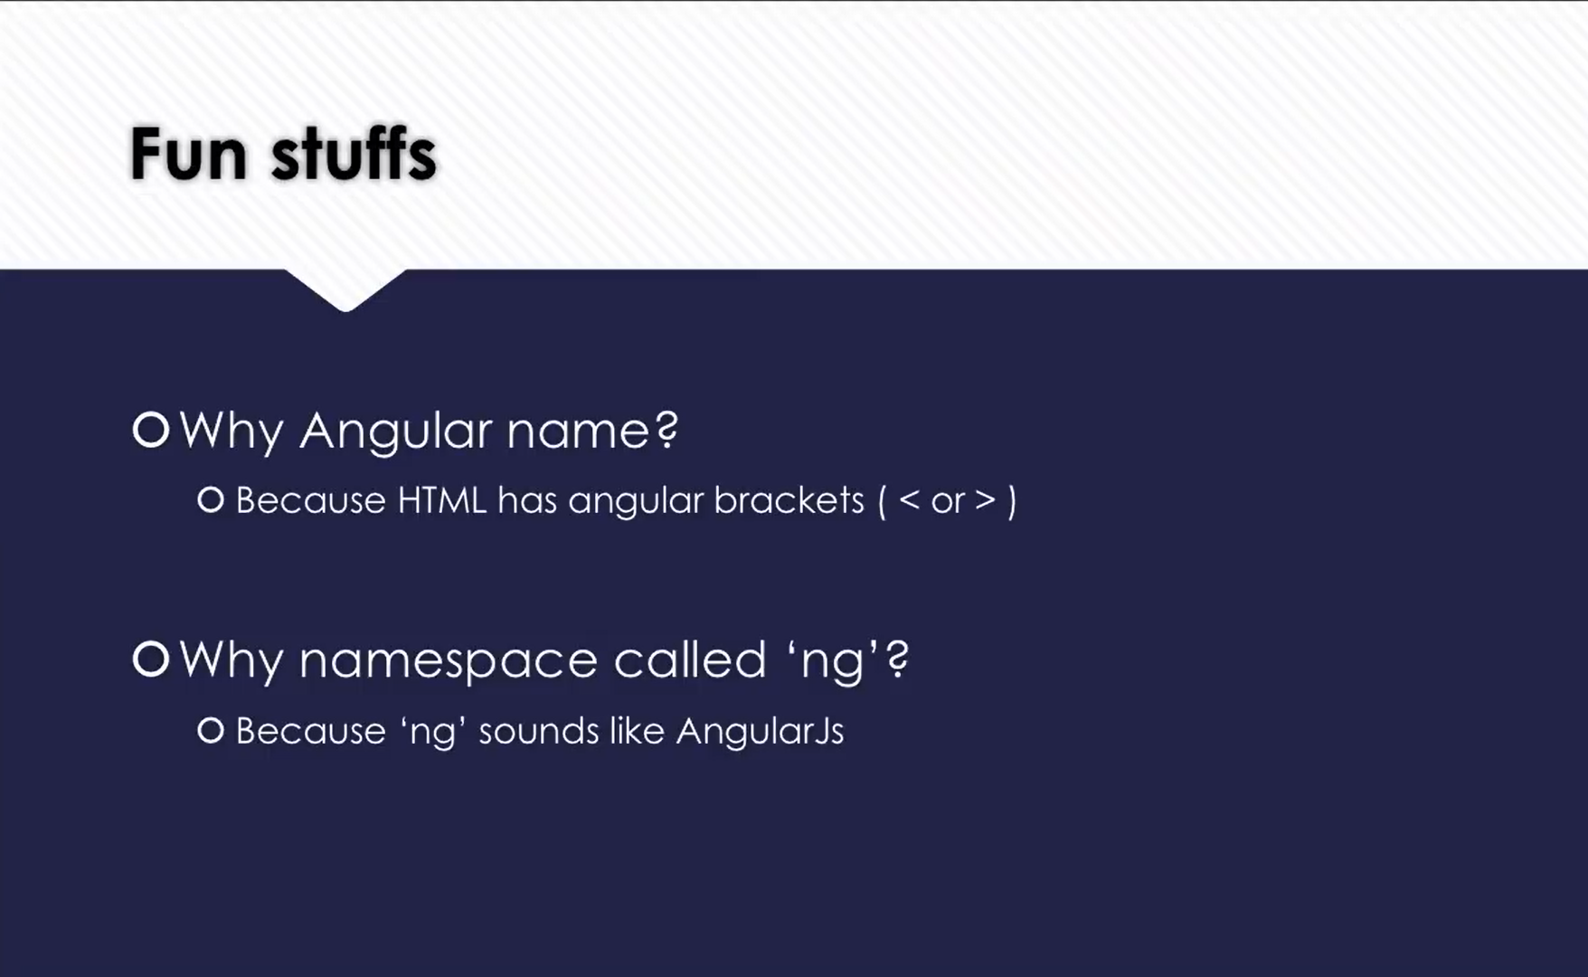
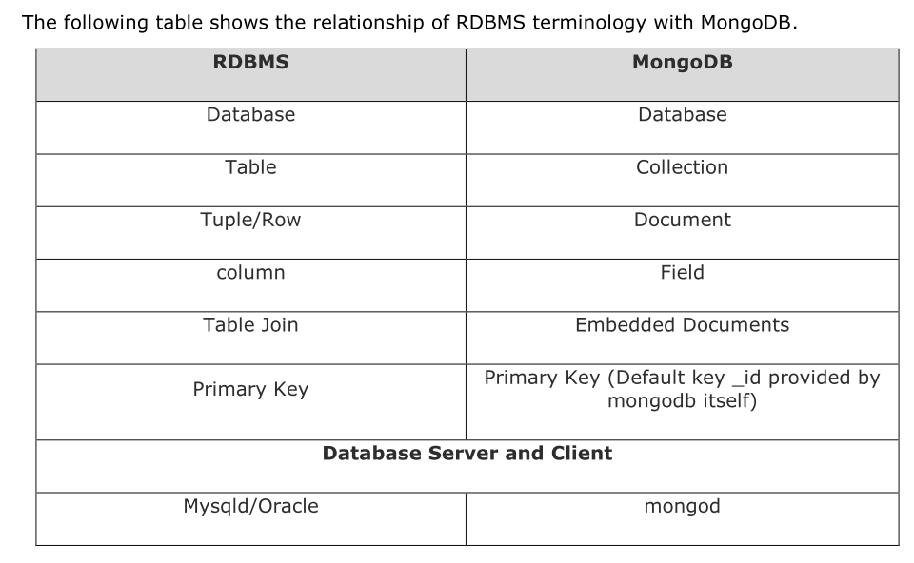

Slide 10
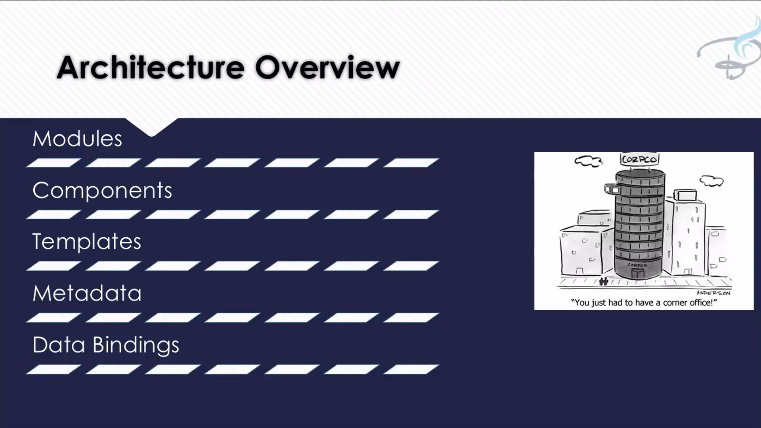
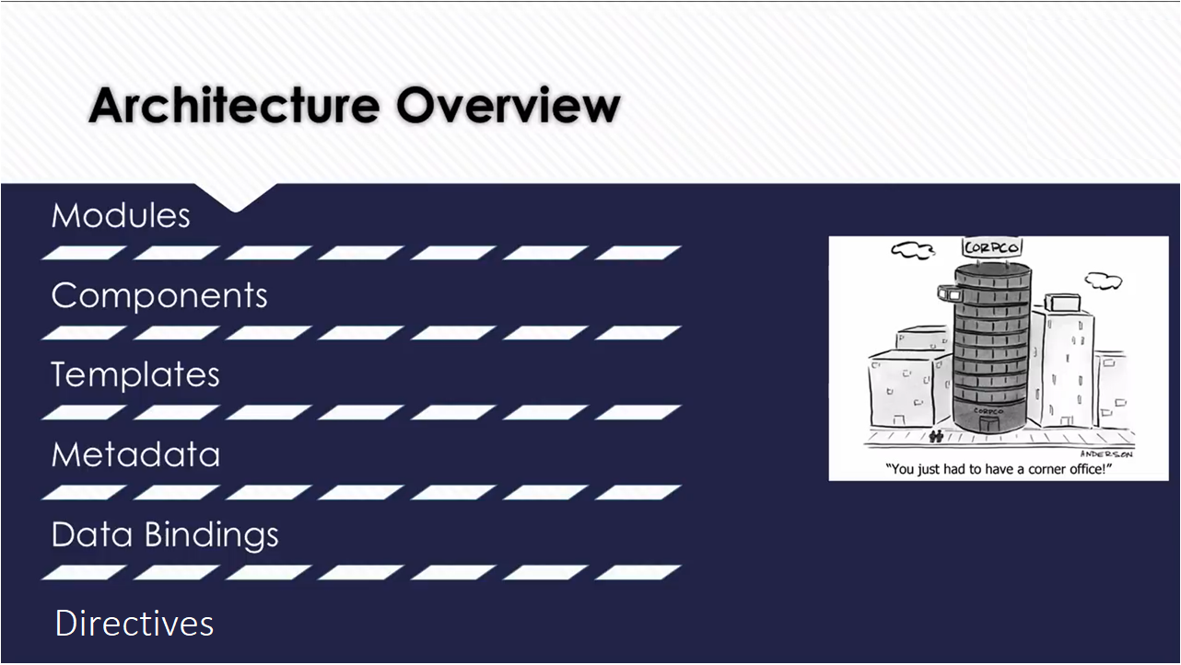
Mongo DB architecture
Architecture : -
Database
Document
Container

Slide 11
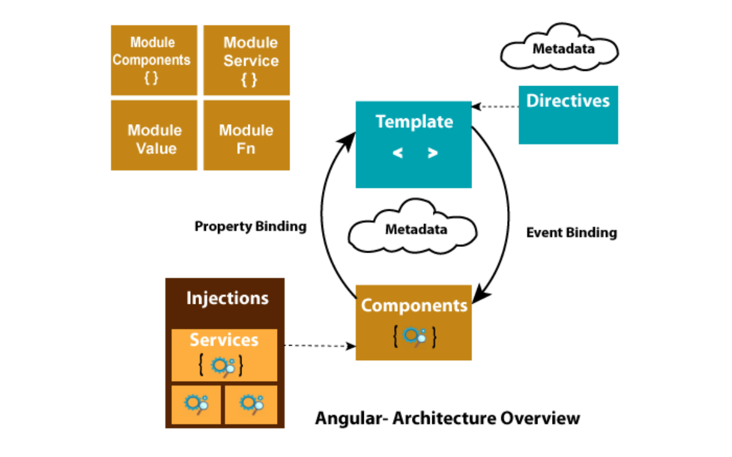
Mongo DB architecture
Architecture : -
Database
Document
Container

Slide 12
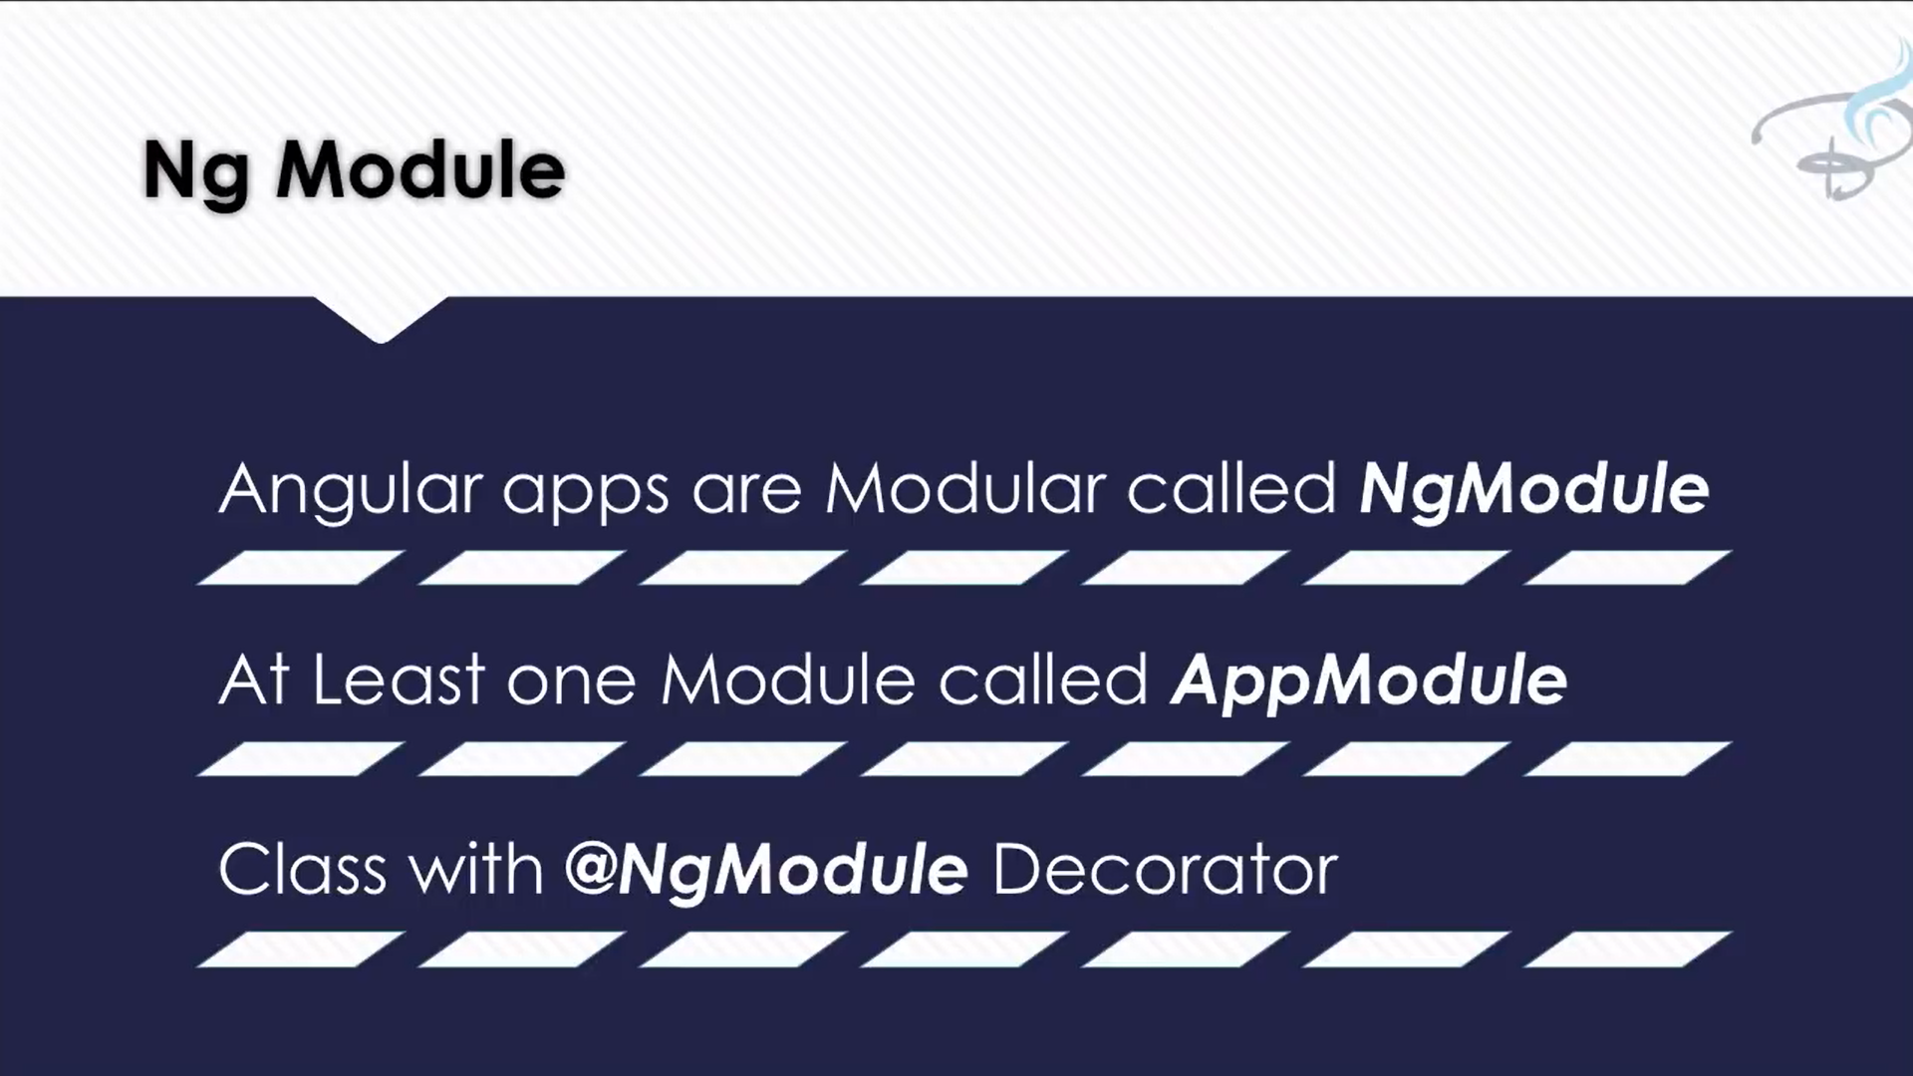
Advantages of MongoDB over RDBMS
Schema less: MongoDB is a document database in which one collection holds different documents. Number of fields, content and size of the document can differ from one document to another.
Structure of a single object is clear.
No complex joins.
Deep query-ability. MongoDB supports dynamic queries on documents using a document-based query language that's nearly as powerful as SQL.
Tuning.
Ease of scale-out: MongoDB is easy to scale.
Conversion/mapping of application objects to database objects not needed.
Uses internal memory for storing the (windowed) working set, enabling faster access of data.

Slide 13
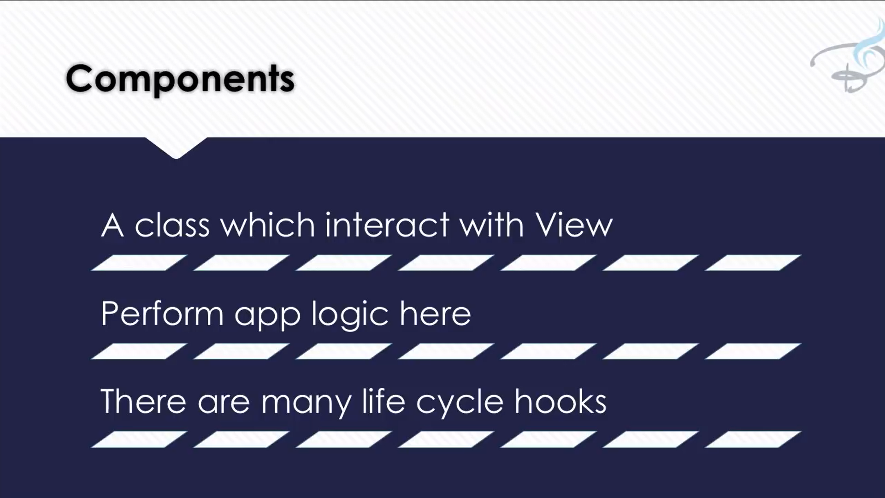
Why Use MongoDB?
Document Oriented Storage: Data is stored in the form of JSON style documents.
Index on any attribute
Replication and high availability
Auto-sharding
Rich queries
Fast in-place updates
Professional support by MongoDB

Slide 14
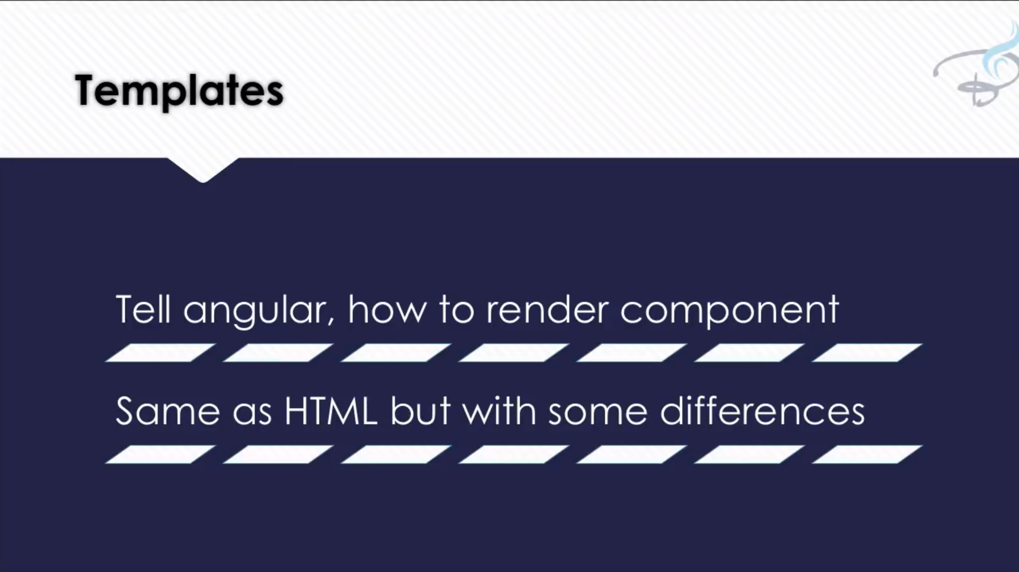
Where to Use MongoDB?
Big Data
Content Management and Delivery
Mobile and Social Infrastructure
User Data Management
Data Hub

Slide 15
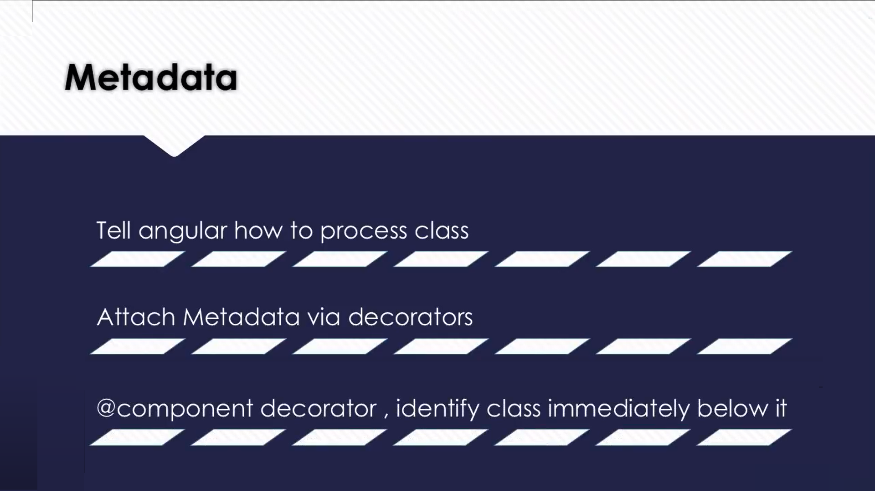
Types of No SQl data base
Key Value pair
Dynamo DB
Azure Table Storage (ATS )
Graph database
Document Based
Mango Db
AmazonSimple DB
Couch DB
Column Oriented database
(#key,#value)
(Name, Tom)
(Age,25)
(Role, Student)
(University, CU)
[
{
"Name": "Tom",
"Age": 30,
"Role": "Student",
"University": "CU",
}
]
Masters
Row Id | Columns
1 | Name | Tom
 | Age | 25
 | Role | Student
Tom
Student
Courses
Bigtable(Google)
Name
Age
CU
Neo4j
Infogrid
HBase
25
Ottawa
Location

Slide 16


